Slide 1
My Health Keeper
Team Aide
Siana Rizwan (180042105)
Farzana Tabassum (180042119)
Sabrina Islam (180042122)

Slide 2
My Health Keeper is a ONE STOP solution where users can store all sorts of health related information in ONE place
2

Slide 3
Features
Storing General Health Information
3
Regular tracking of health related general information like -
Blood pressure
Pulse rate
Blood sugar level
Weight

Slide 4
Features
2. Diet Plan
4
Log his/her consumed food items along with its amount and our application will calculate the calories intake.
Calculate his/her BMI. From the result, the application will suggest necessary steps for maintaining a healthy lifestyle for the user.
Monitor his/her weight.
Advantage:
It is especially useful for those who are planning to lose/gain weight

Slide 5
Features
3. Storing Specialized Health Information
5
User can record any kind of abnormalities/diseases by -
Writing notes about his/her situation including its date
Uploading health related files and prescriptions etc.
Advantage:
Health related reports and other necessary information will be stored in a specific place

Slide 6
Features
4. Report Analysis
6
User can upload two types of report -
MRI report of the brain
X-Ray report of the lungs
Our application will analyze the report and will give a list of probable diseases accordingly with a suggestion to visit the required doctor
Advantage:
Patient can get a basic idea regarding what’s wrong and where/to whom to go

Slide 7
Features
5. Disease Prediction
7
User can choose his/her evident symptoms then our application will showcase the possibility of probable diseases in percentage and so type of doctor will be suggested accordingly
Advantage:
Patient can get a basic idea regarding what’s wrong and where/to whom to go

Slide 8
Features
6. Medicine Reminder
8
User can list the names of medicines and set time and duration for them and a chart will be created accordingly. Before every medication a notification will be send as a reminder.
Advantage:
Now users cannot forget to take their medicines timely!
Track of medication can be maintained

Slide 9
Features
7. Menstrual Cycle Tracker
9
For female users, our application will have an additional feature where she can keep a track of the menstruation cycle by storing information like –
Starting of the cycle
Ending of the cycle
Duration of each cycle to come
Daily log
Advantage:
Easiest way to keep track of women’s menstrual cycle

Slide 10
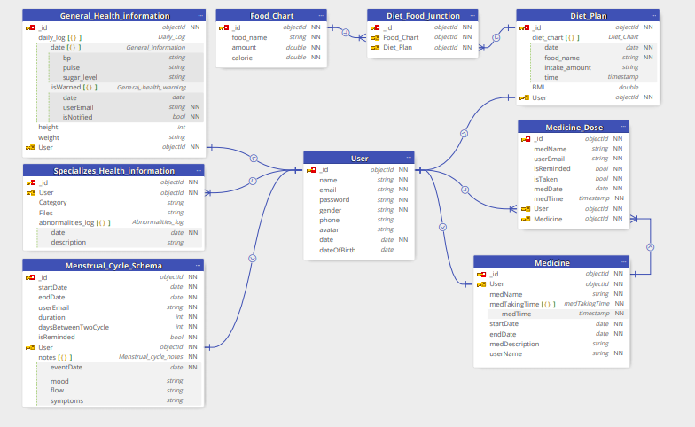
ER-Diagram
10

Slide 11
The floor is open for Q/A
11
Thank You!

